Slide 1

Project review
ANOOJA S ANIYAN
ROLL NO:30
S3-MCA

Slide 2
PERSONALITY PREDICTION USING MACHINE LEARNING

Slide 3
DESCRIPTION OF THE TOPIC
The Big Five model is also known as the Five-Factor Model (FFM) and was developed in the early 1980s according to psychological theories.
When the statistical analysis is applied to personality survey data, some words used to describe the person and these words give a summary of the overall character or personality of the person accurately.

Slide 4
OBJECTIVE
The objective of this project is to analyse and classify personalities of a given set of people or an individual using advanced data mining concepts

Slide 5
UI DESIGN
The structure we will use is a standard flask application structure with an index.html file
that will contain our user interface and host our results and a python file with the code to create our application.
#Structure of the flask application
----Root folder --Base data files #This is basically just the csv with the base data from kaggle --application.py #This is the main python code file ----templates --index.html #The templates folder contains our index.html file with the user interface ----static #The static folder contains any images we will want to display in the application.

Slide 6
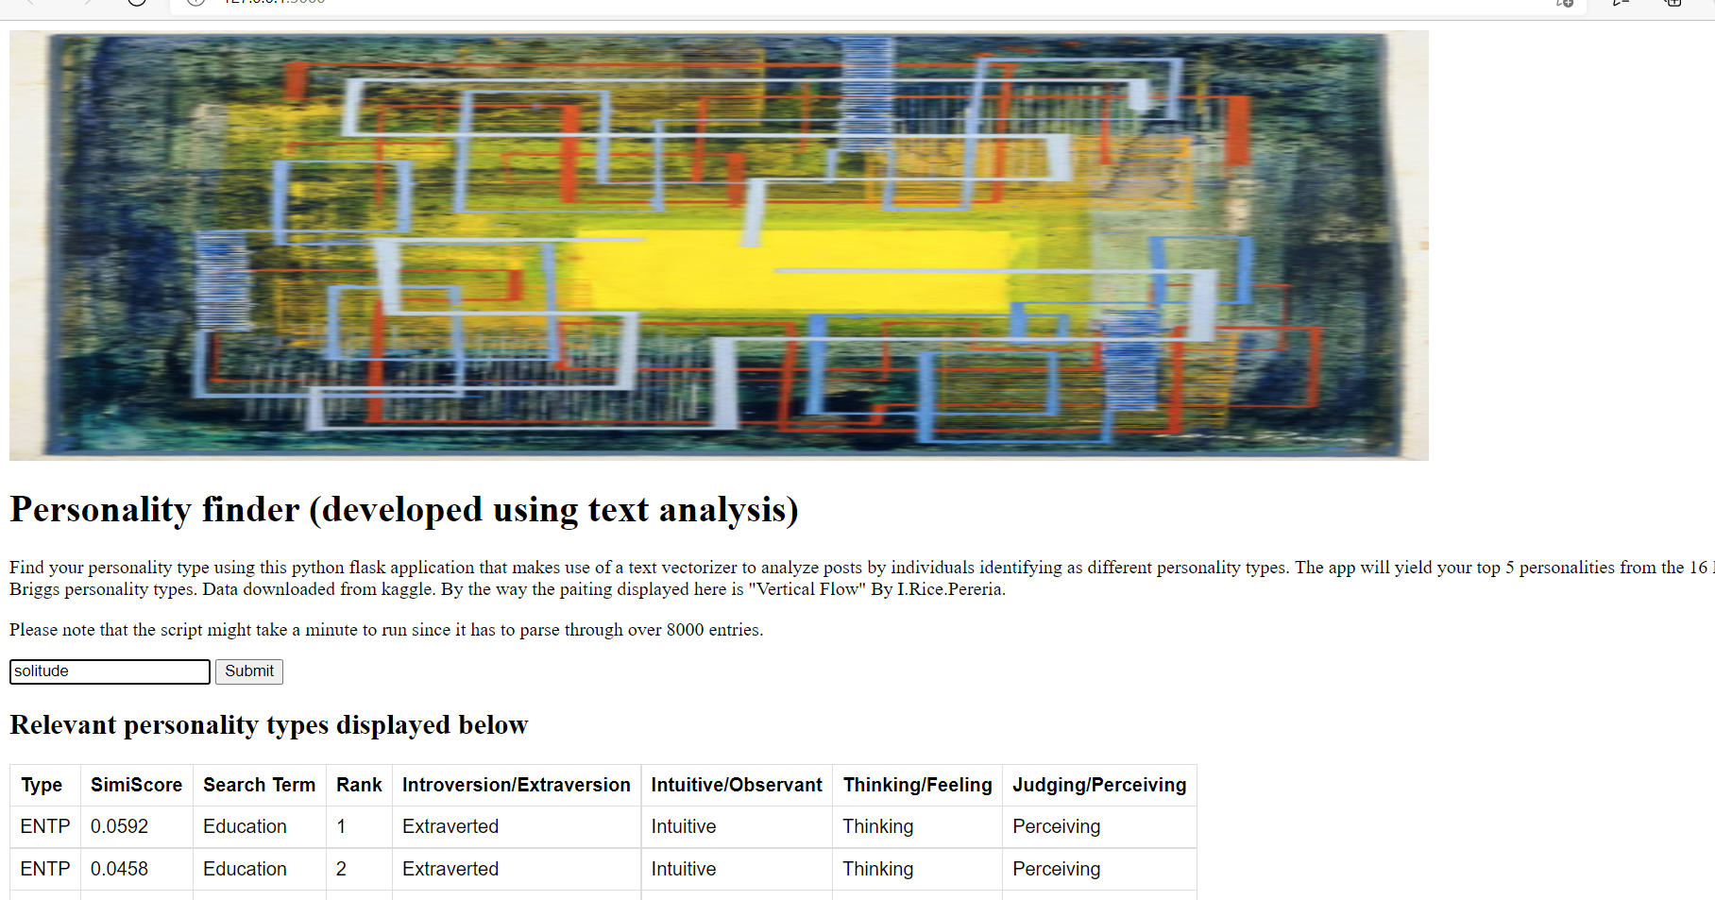
input/output

Slide 7
CODE description
The first part of the index.html file is easy. This is just some basic text that describes the application itself and a simple image of the painting above that we will host in our ‘static’ folder.

Slide 8
FLASK
Flask is a web framework, it’s a Python module that lets you develop web applications easily. It’s has a small and easy-to-extend core.
Flask is a web application framework written in Python. It was developed by Armin Ronacher, who led a team of international Python enthusiasts called Poocco.

Slide 9
PYTHON CODE
#Import required packagesfrom flask import Flask, flash, redirect, render_template, request, session, abort,send_from_directory,send_file import pandas as pd import numpy as np import json import xlrd from sklearn.feature_extraction.text import TfidfVectorizer#Create a flask application application= Flask(__name__)#Create an application route @application.route("/",methods=["GET","POST"])

Slide 10
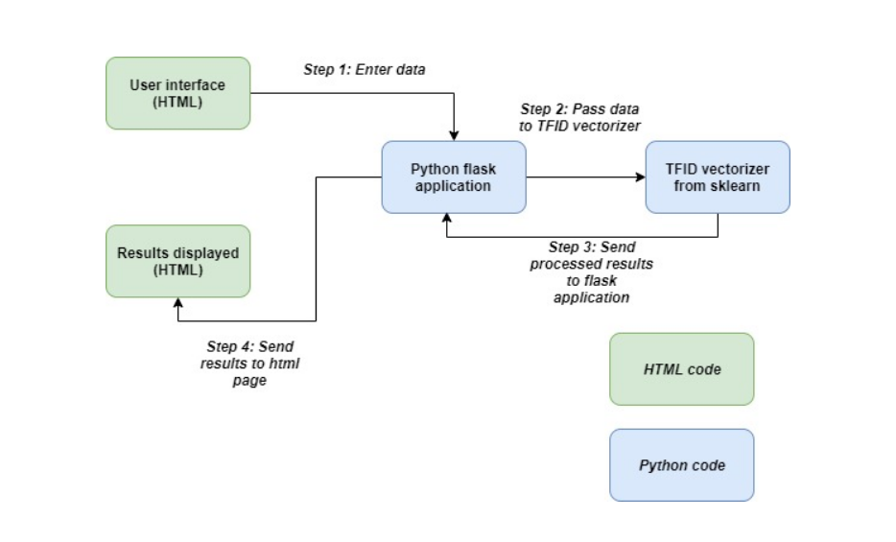
DIAGRAMS

Slide 11
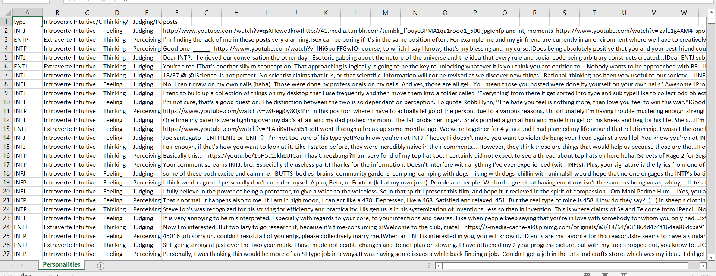
DATASETS

Slide 12
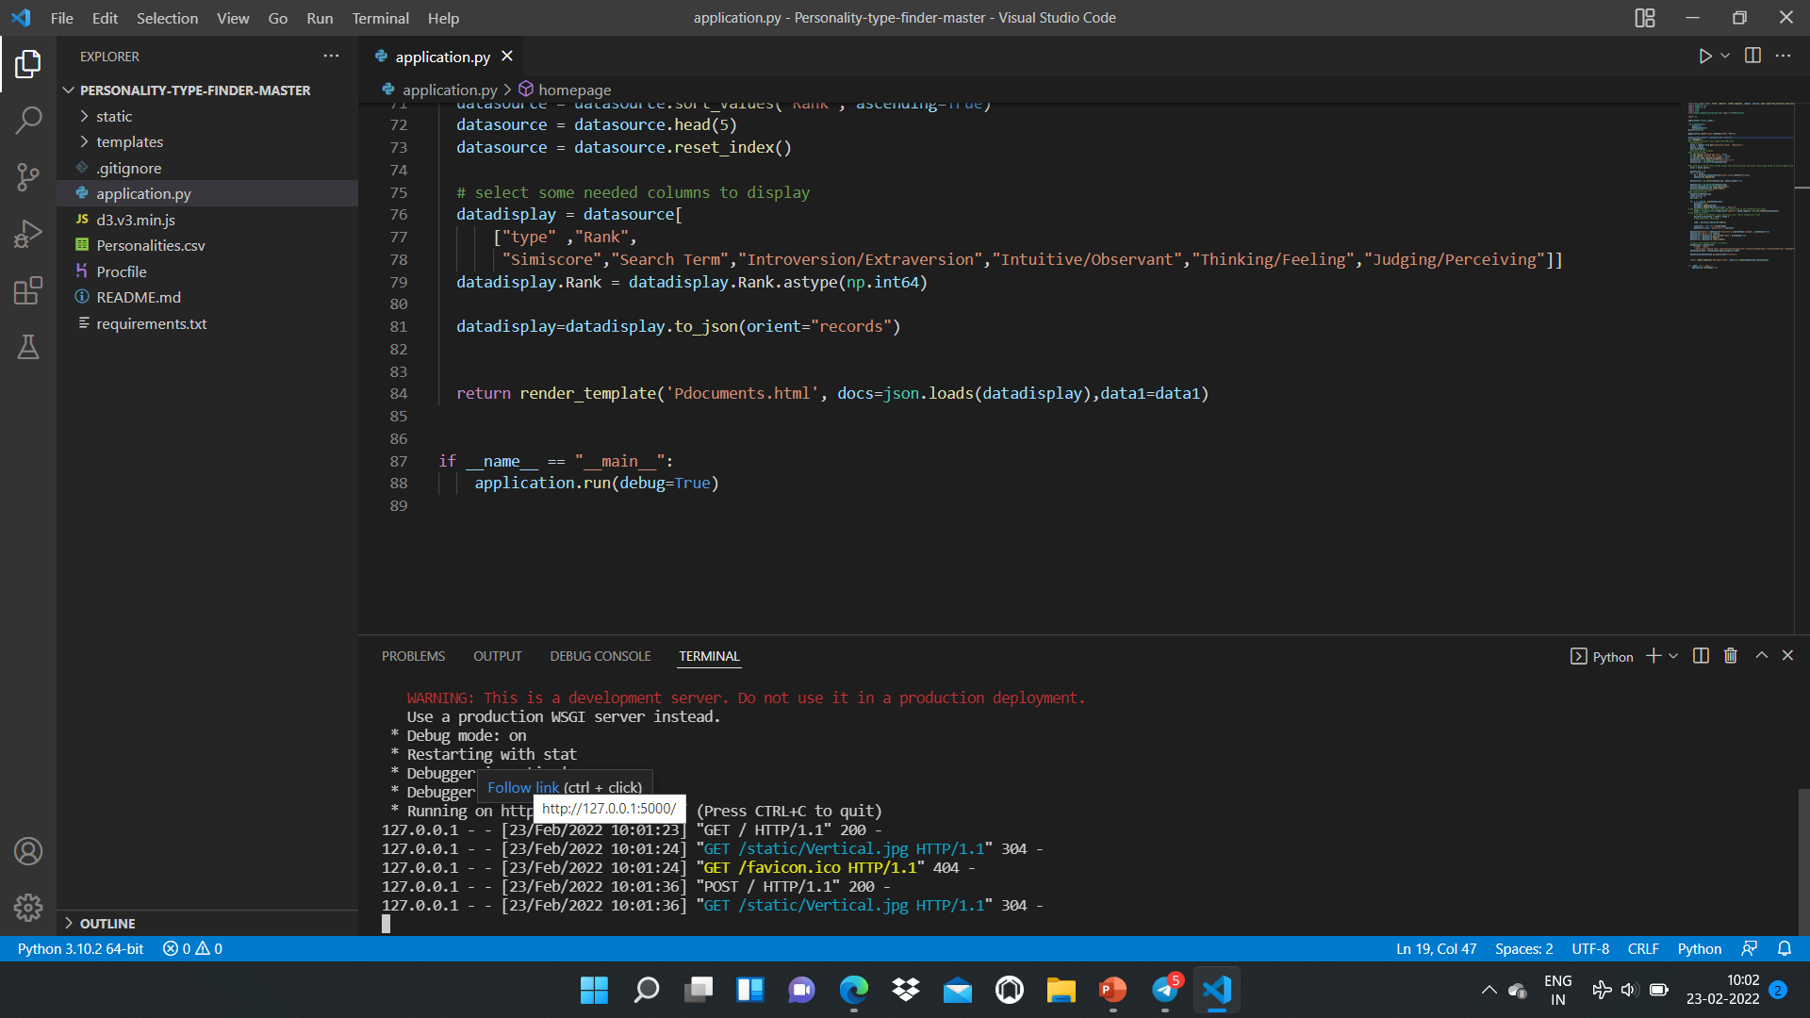
SAMPLE SCREENSHOTS

Slide 13
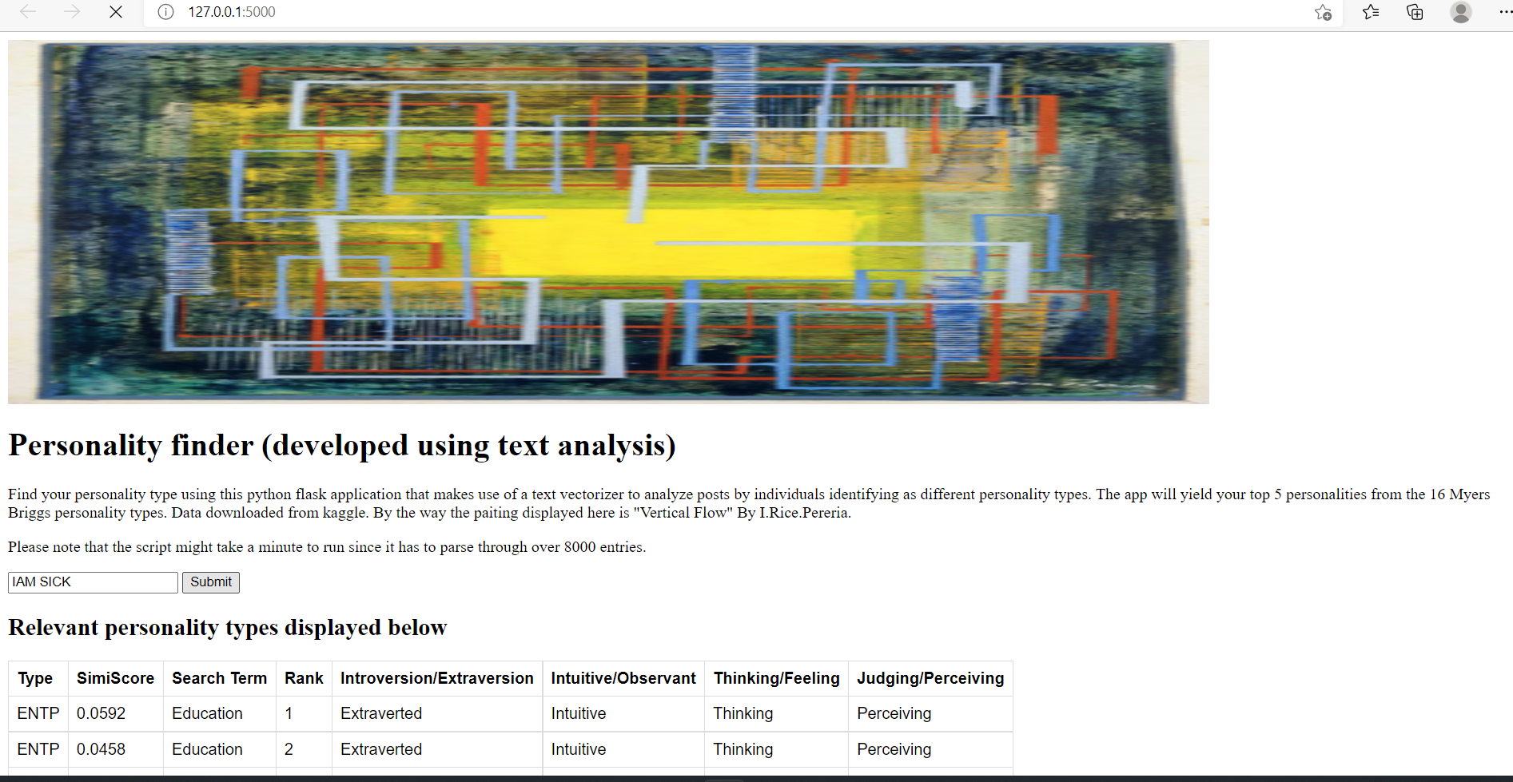

Slide 14
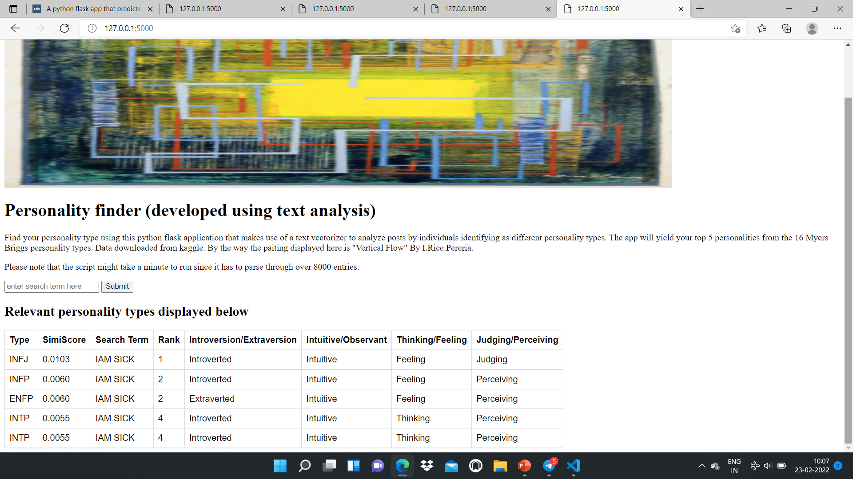

Slide 15
FUTURE SCOPE
Personality traits are generally referred to as relatively stable patterns of thoughts, feelings, and behaviours that have been associated with a wide range of important life outcomes and choices.

Slide 16
THANK YOU

